Slide 1
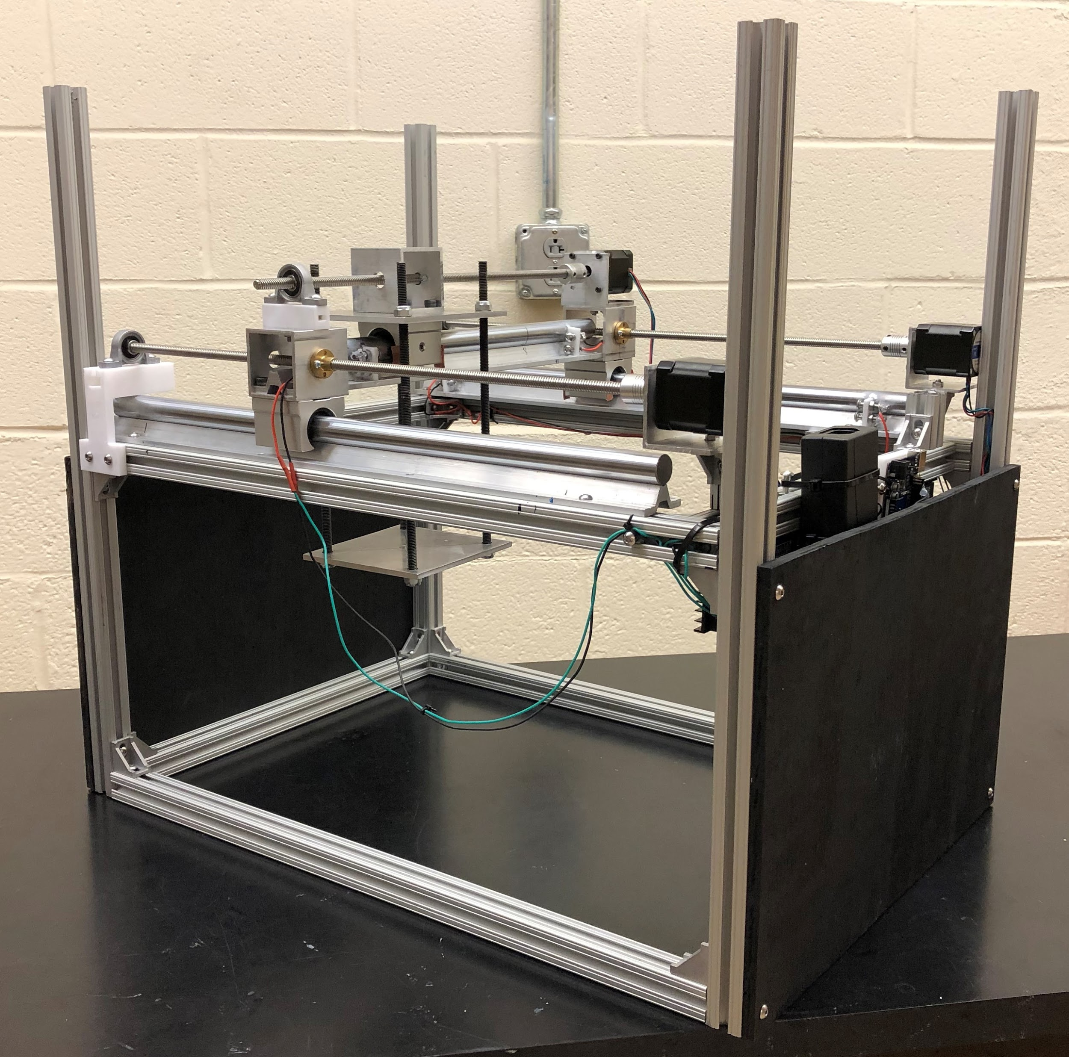
Radiation Detector Spatial Calibration System
Detector Detectives
Zach Hainsel
Clayton Kirberger
Elizabeth Davis
December 16, 2019

Slide 2
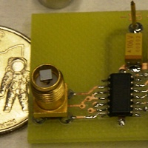
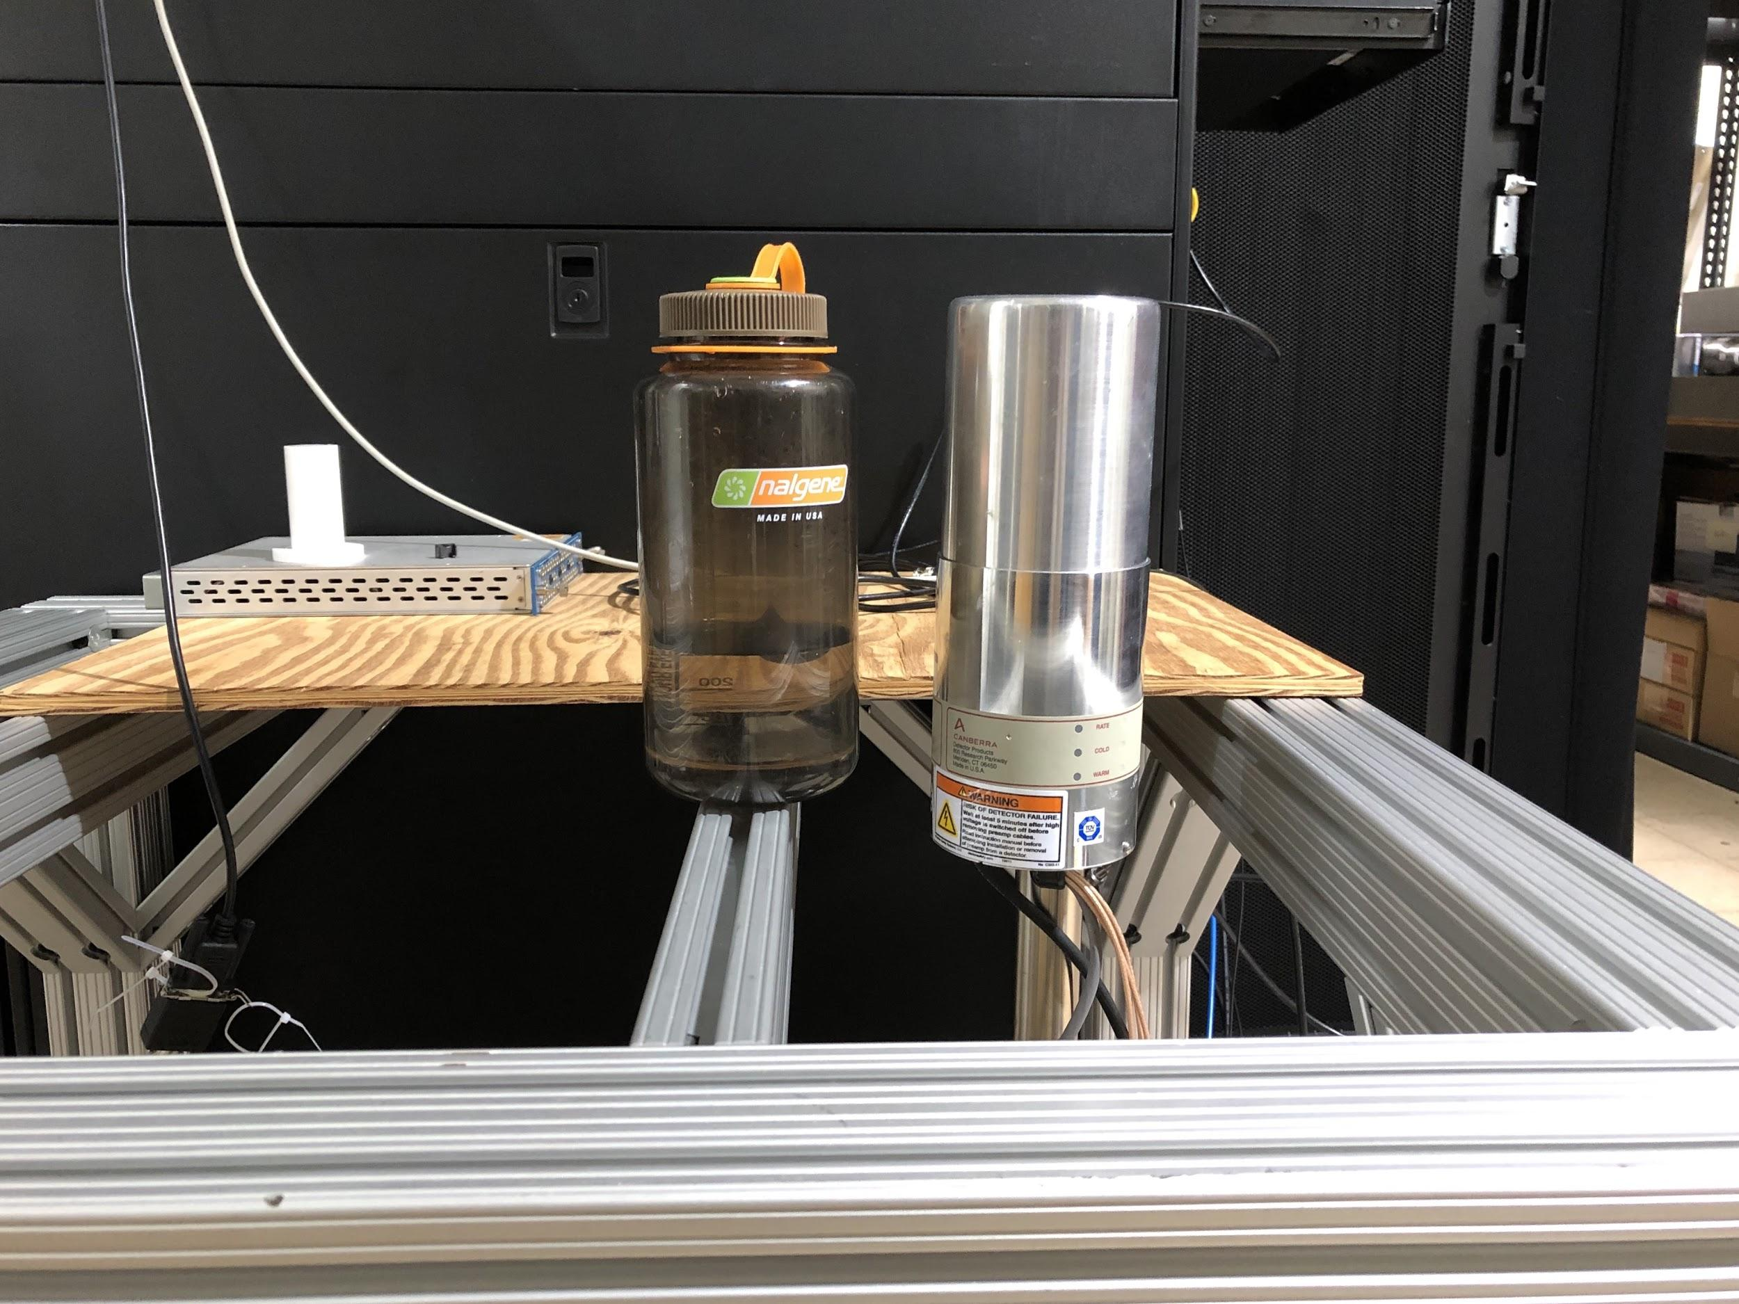
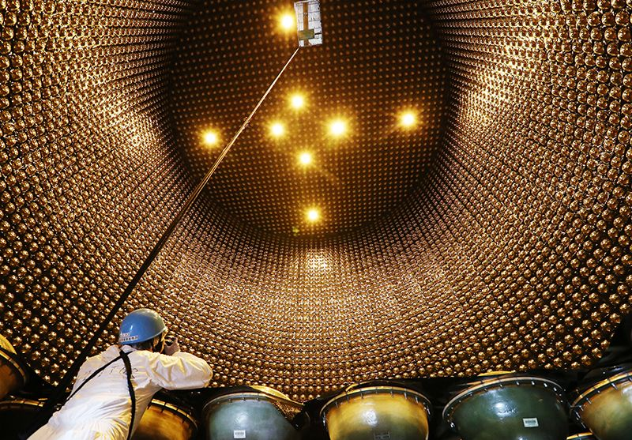
Radiation Detectors
Incident ionizing radiation is converted to a measurable voltage proportional to radiation energy
Detectors range in size from smaller than a coin to larger than a house
Our project can characterize detectors that are roughly the size of a ream of paper (20cm x 40cm) or smaller
Size scale
Smaller than coin
Water bottle
Grain Silo
Notes:
They work by converting ionizing radiation to voltage
Detectors have a vast range when it comes to size
Our project deals with detectors that can fit within a region of the size of a piece of paper

Slide 3
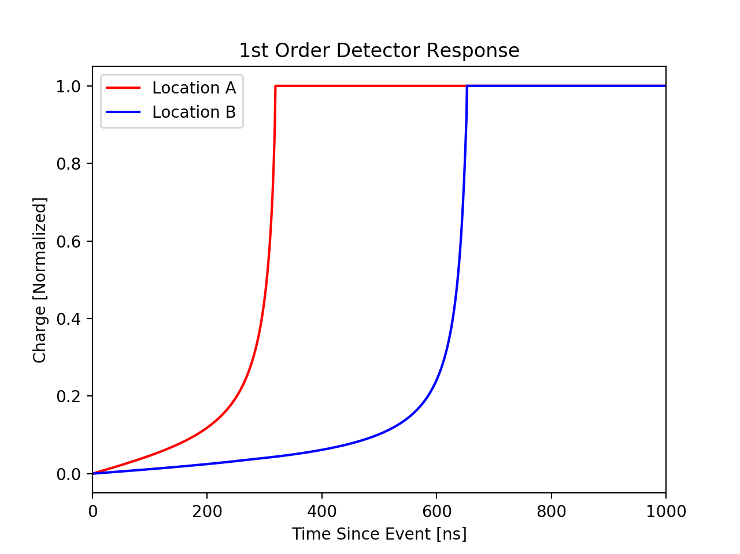
Detector Response Can Vary
Detector response from identical events can vary based on interaction location
Variation in detector response introduces error in experiments and affects repeatability
This variation in detector response increases over time
Notes:
Detector response from identical events can vary based on the location of where they occur on the detector
This affects experiment reliability
This is not well understood and it becomes more pronounced over time

Slide 4
Project Goal
Build a tool which can create a gamma ray beam and accurately target that beam at radiation detectors based on user inputs.

Slide 5
Building a Tool
Develop a tool to spatially characterize detector response
Gamma radiation beam from collimator scans detector surface
Detector output at each location is recorded over time
Detector output can be mapped with source position
Notes:
Goal of our project is to build a scientific tool to spatially characterize detector response
Gamma source scans detector surface and detector output is recorded at each location over time
“mapping “ detector output

Slide 6
Specifications
y
Source
Design a collimator that produces the smallest beam diameter within weight limit
Position source over a 2D range of at least 20cm x 40cm
Device should remain autonomous during a scan
Beam position must be repeatable with a precision of 0.5 mm or better
Beam position must be made available for readout
x
5 mm
Detector
6
20 cm
40 cm

Slide 7
Segmented Design
Collimator Zach | Positioning System Clayton | Control Systems Elizabeth
Creates gamma ray beam from an isotropic source | Controls where the gamma radiation beam hits the detector with 0.5mm accuracy in a 20cm x 40cm area | Control, monitor, and output position of collimator based on user inputs

Slide 8
Providing Focused Gammas Rays
Gamma rays have energies on the order of 1 MeV
This means gammas cannot be focused like lower energy photons due to shorter wavelengths
A pinhole-like device can be used to produce a focused beam of gamma rays
Collimator

Slide 9
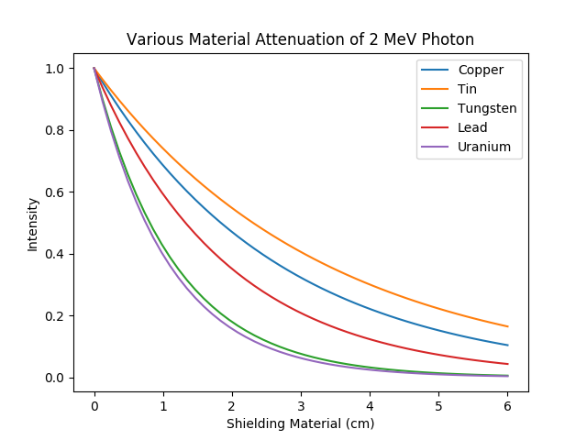
Material
Gamma intensity decreases following an exponential
The decay constant represents a value relating to the atomic number and photon energy
Most materials that are excellent at shielding are prohibitive in some way
Lead represents the best material within the bounds of this project
Notes:
3 main types of radiation: alpha, beta, gamma
Of the 2, gammas have the shortest wavelength
This

Slide 10
Modeling The Collimator
This system can be modeled with a basic a Monte Carlo simulation by calculating the survival probability for a particular region
We want to maximize the fraction of events within the center of the collimator
The dimensions can float in order to determine the optimal collimator geometry
Collimator
Radiation Detector
Notes:
3 main types of radiation: alpha, beta, gamma
Of the 2, gammas have the shortest wavelength
This

Slide 11
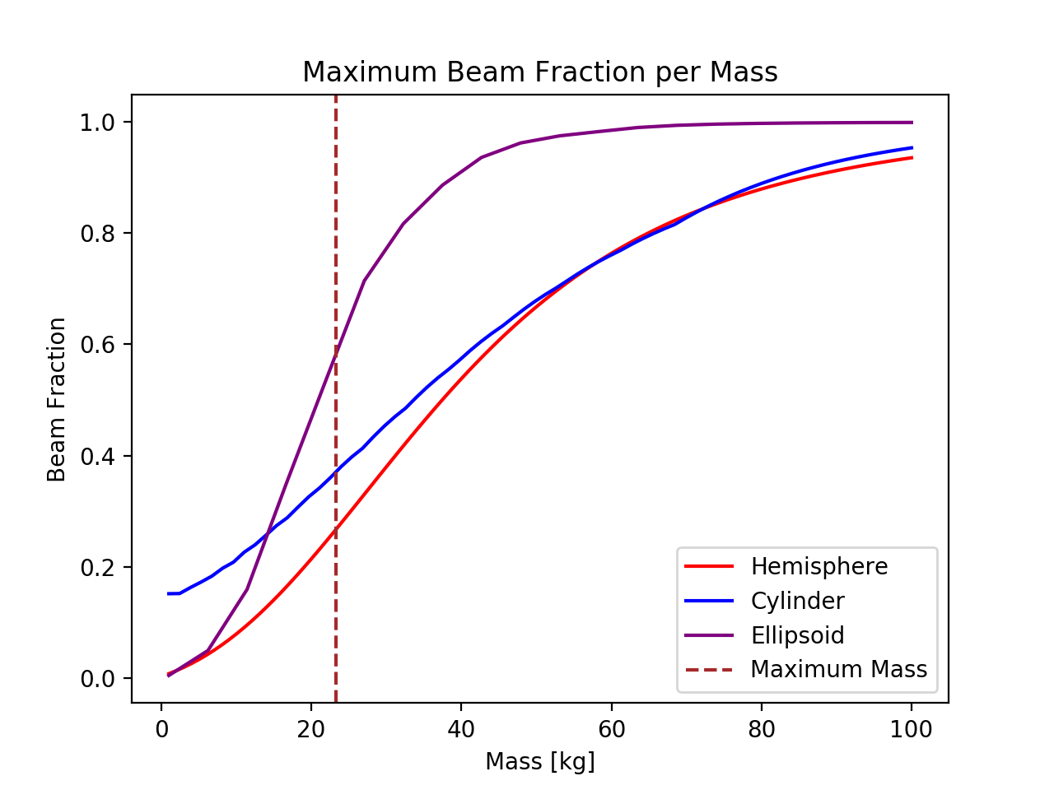
Choosing a Collimator
Three basic shapes were chosen to be modeled based on an ability to model and to simplify machining
Due to the rectangular scanning region, an extruded ellipse was determined to be the best base geometry
Notes:
3 main types of radiation: alpha, beta, gamma
Of the 2, gammas have the shortest wavelength
This

Slide 12
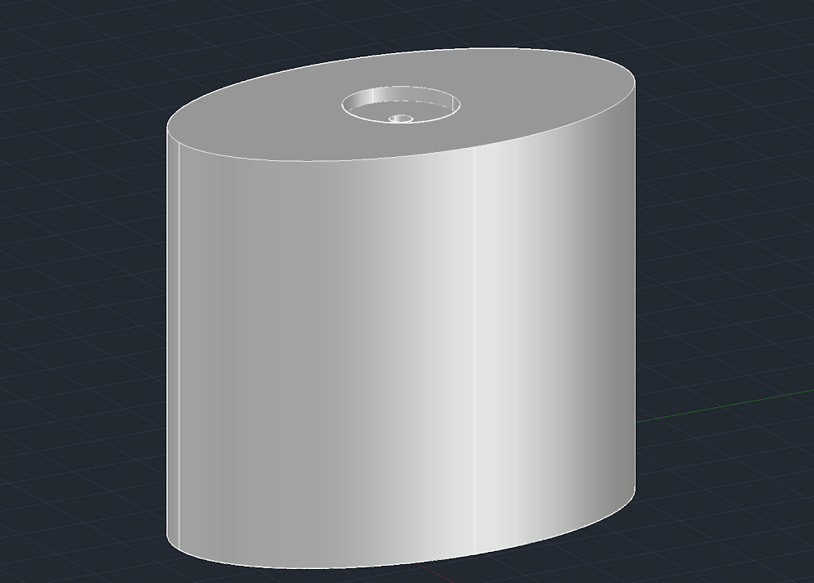
The Product
The goal of this section was to provide the best design for a collimator
A more complex geometry may have yielding a better result with diminishing returns, this would greatly increase simulation and machining complexity
The final design is segmented for ease of machining and portability
This collimator design will be machined in the near future by a machine shop due to health concerns
5.2cm
8.55cm
14.5cm
Notes:
3 main types of radiation: alpha, beta, gamma
Of the 2, gammas have the shortest wavelength
This

Slide 13
Segmented Design
Collimator Zach | Positioning System Clayton | Control Systems Elizabeth
Creates gamma ray beam from isotropic source | Controls where the gamma radiation beam hits the detector with 0.5mm accuracy in a 20cm x 40cm area | Control, monitor, and output position of collimator based on user inputs

Slide 14
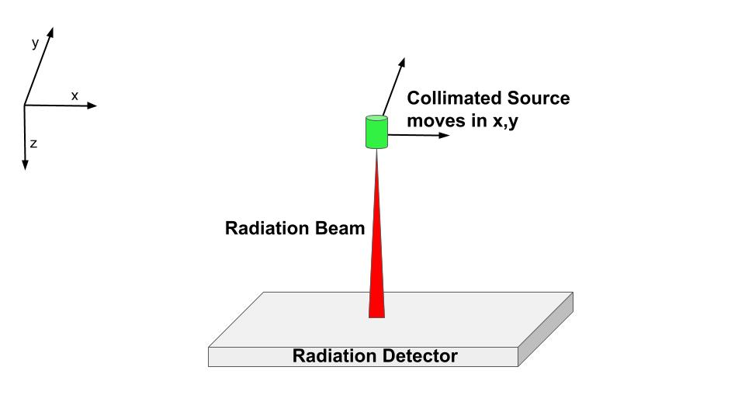
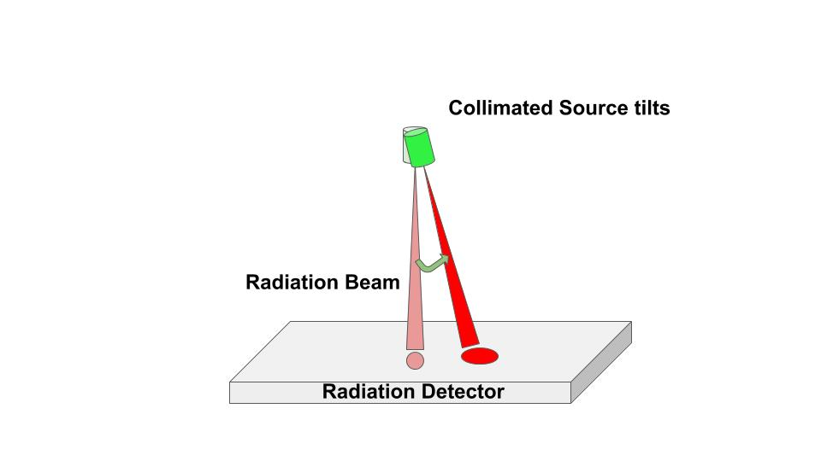
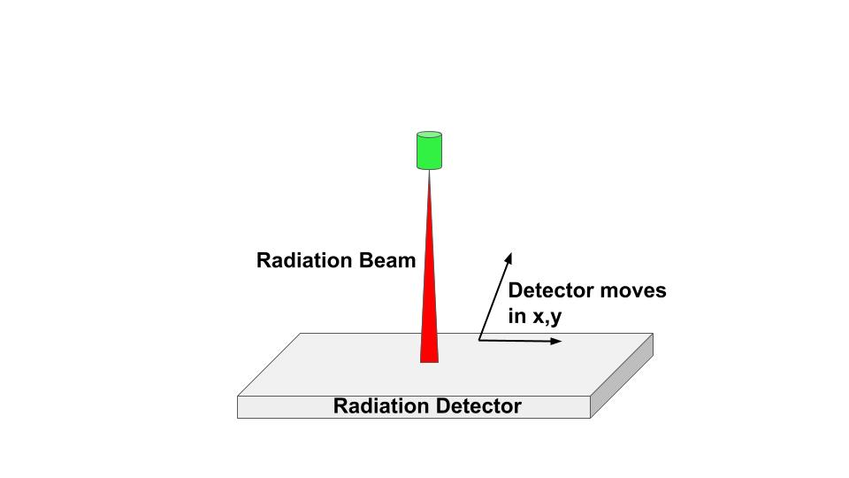
How to Target the Beam
Move Collimator |  | Tilt Collimator |  | Move Detector
Pros | Cons | Pros | Cons | Pros | Cons
Consistent beam diameter We control collimator properties Many options to achieve motion | Difficult to move heavy collimator | Least amount of movement We control collimator properties | Decreased beam precision at wide angles Complicated control software | Consistent beam diameter | Must accommodate all detector shapes and sizes Detector must be fully functional while using our device

Slide 15
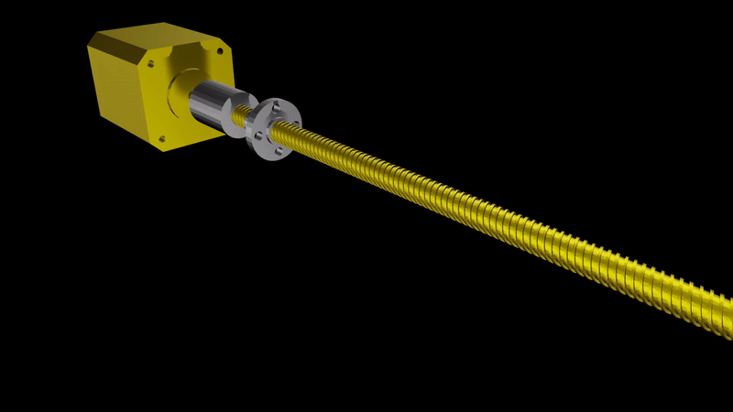
How to Move the Collimator
We will use stepper motors and lead screws
Can achieve 0.5mm accuracy
No significant safety hazards
Relatively Cheap
Other considerations belts, hydraulics, and maglev

Slide 16
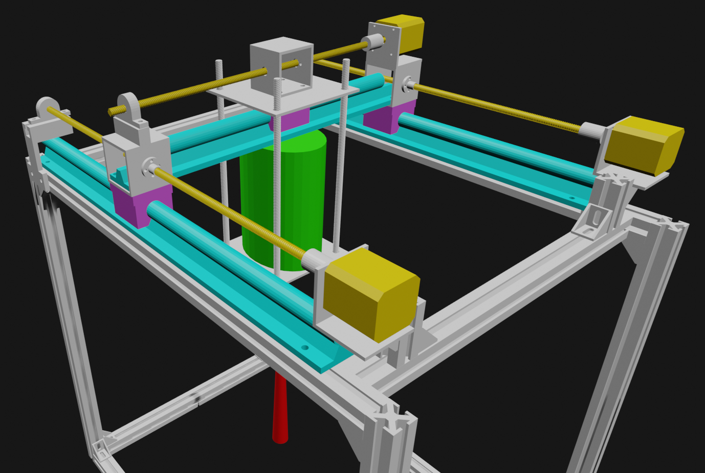
System Layout
Collimator
Linear Guide Rail
Stepper Motor + Lead Screw
Ball Bearing Carriage
Gamma Beam

Slide 17
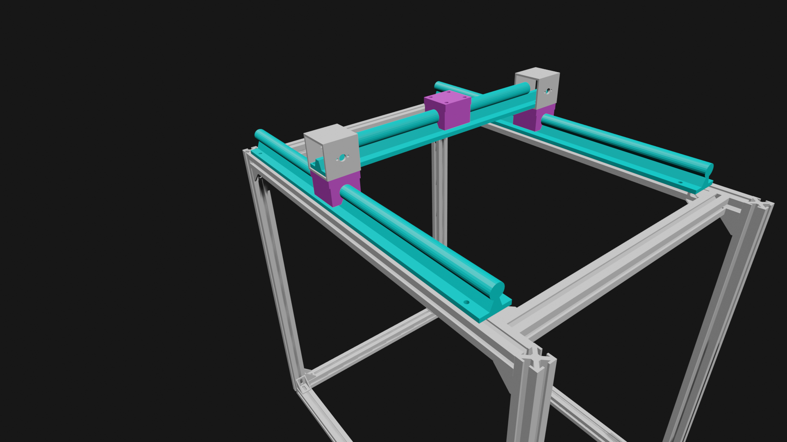
Linear Guide Rails and Carriages
Collimator weight is supported by guide rails
Ball bearing carriages make moving the heavy collimator easier

Slide 18
Is Beam Bending a Problem?
Collimator Weight W Here
Most bending will occur along the shorter guide rail
Maximum deflection will occur at center of guide rail
Treat system like point load at the center of beam supported at both ends
W
L = 45cm

Slide 19
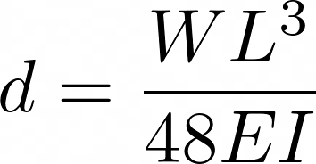
Finding Maximum Deflection
d | Maximum Deflection | ?
W | Weight on Guide Rail | ?
E | Modulus of Elasticity | ?
I | Area Moment of Inertia | ?
L | Length of Beam | 17.7in
d | Maximum Deflection | ?
W | Weight on Guide Rail | ?
E | Modulus of Elasticity | 2*10⁸ kpa
I | Area Moment of Inertia | 0.791 cm⁴
L | Length of Beam | 45 cm
Need to calculate area moment of inertia I
Guide rail has a complicated cross section
I’ll ignore the aluminum part for now to set an upper limit on d
Guide Rail Cross Section
1cm
Steel
Aluminum

Slide 20
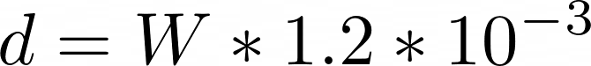
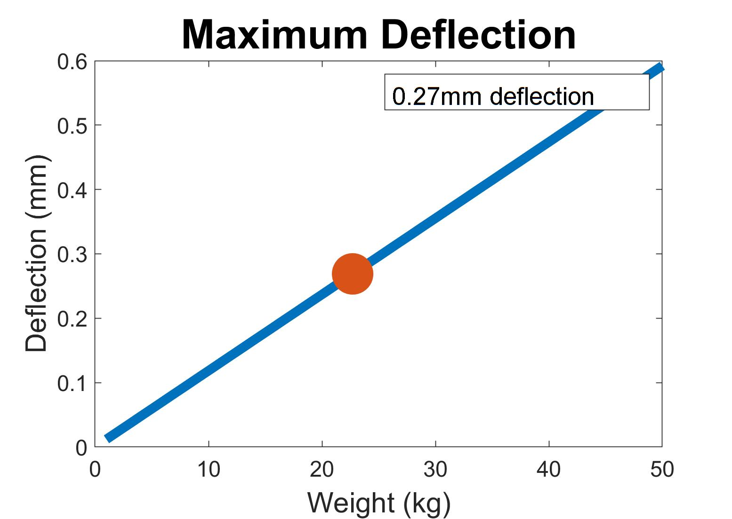
Beam Bending Isn’t a Concern
Plug in constants and graph relation between d and W
d for 22.7kg is 0.27mm
This is a rather significant overestimate of the maximum deflection
This estimate suggests beam bending shouldn’t be a concern

Slide 21
Segmented Design
Collimator Zach | Positioning System Clayton | Control Systems Elizabeth
Creates gamma ray beam from isotropic source | Controls where the gamma radiation beam hits the detector with 0.5mm accuracy in a 20cm x 40cm area | Control, monitor, and output position of collimator based on user inputs

Slide 22

Control Systems
What needs to be accomplished?
Time
Position collimated gamma source over detector surface
Record position of detector over time
Collimated Gamma Source
Scanned region

Slide 23

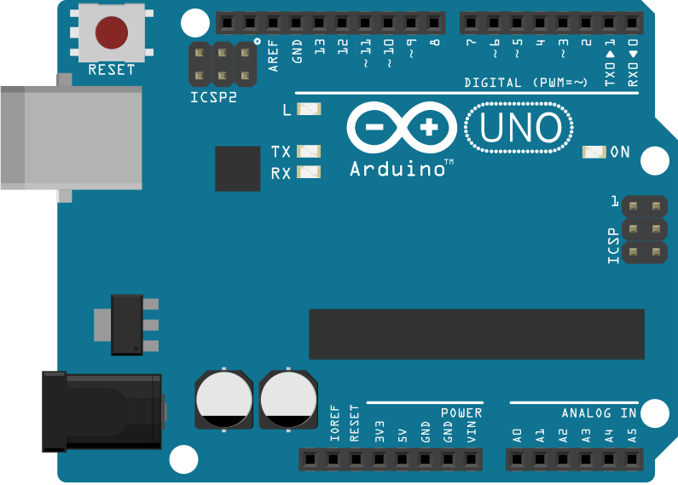
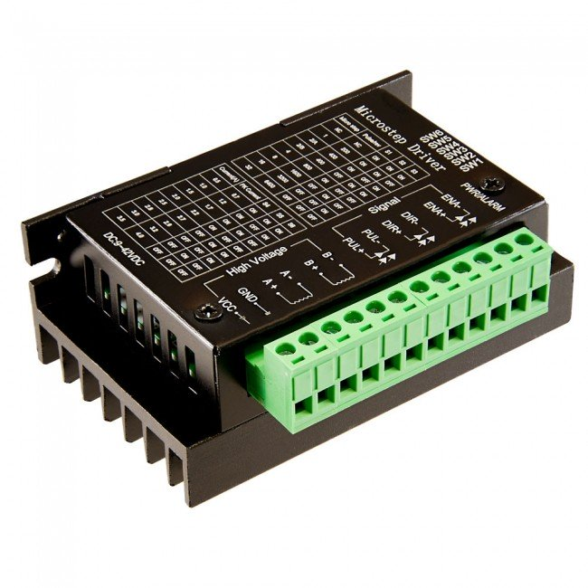
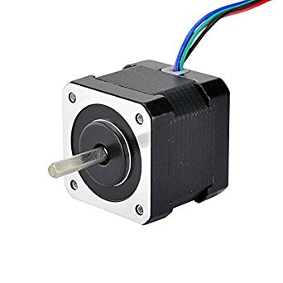
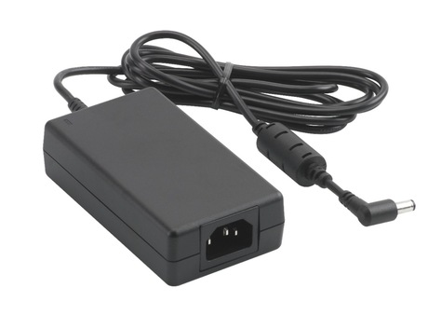

Control Systems
Zero point in scanning region
Size of scanning region
Which motor to move
Stepper Motor Driver
Stepper Motor
Scanning resolution
Data Acquisition Computer
Which direction (ccw or cw)
Arduino
Time to spend at each spot over detector
Number of steps to take
Text File
(timestamp, x,y)
Power Supply

Slide 24

Control Systems
User Inputs at Start of Scan
Zero point in scanning region
Size of scanning region
Scanning resolution
Data Acquisition Computer
40 cm
Time to spend at each spot over detector
Home Position
20 cm

Slide 25
Control Systems
Zero point in scanning region
Size of scanning region
Which motor to move
Stepper Motor Driver
Stepper Motor
Scanning resolution
Data Acquisition Computer
Which direction (ccw or cw)
Arduino
Time to spend at each spot over detector
Number of steps to take
Text File
(timestamp, x,y)
Power Supply

Slide 26
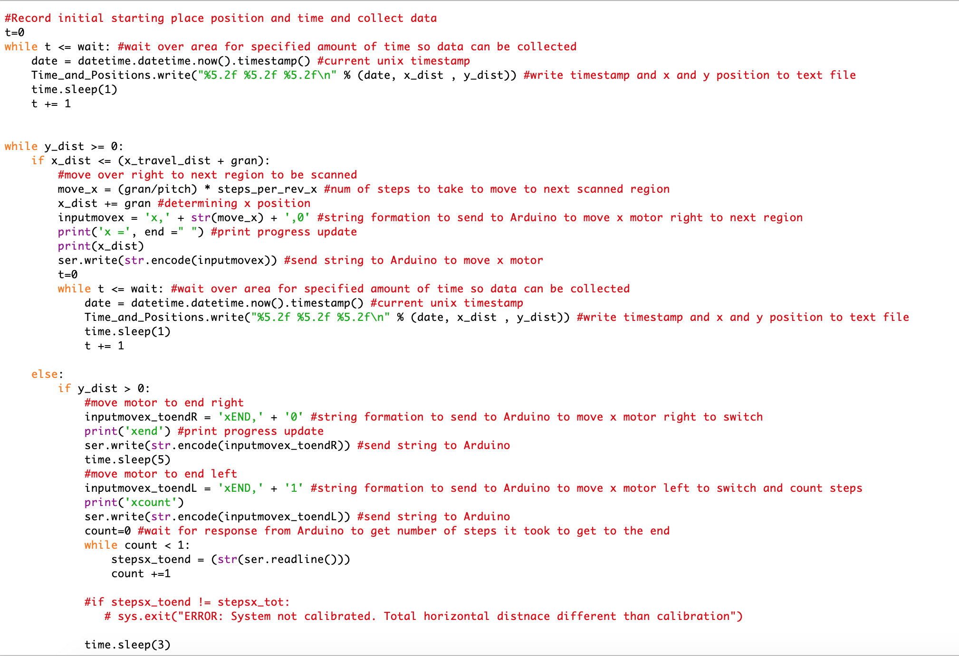
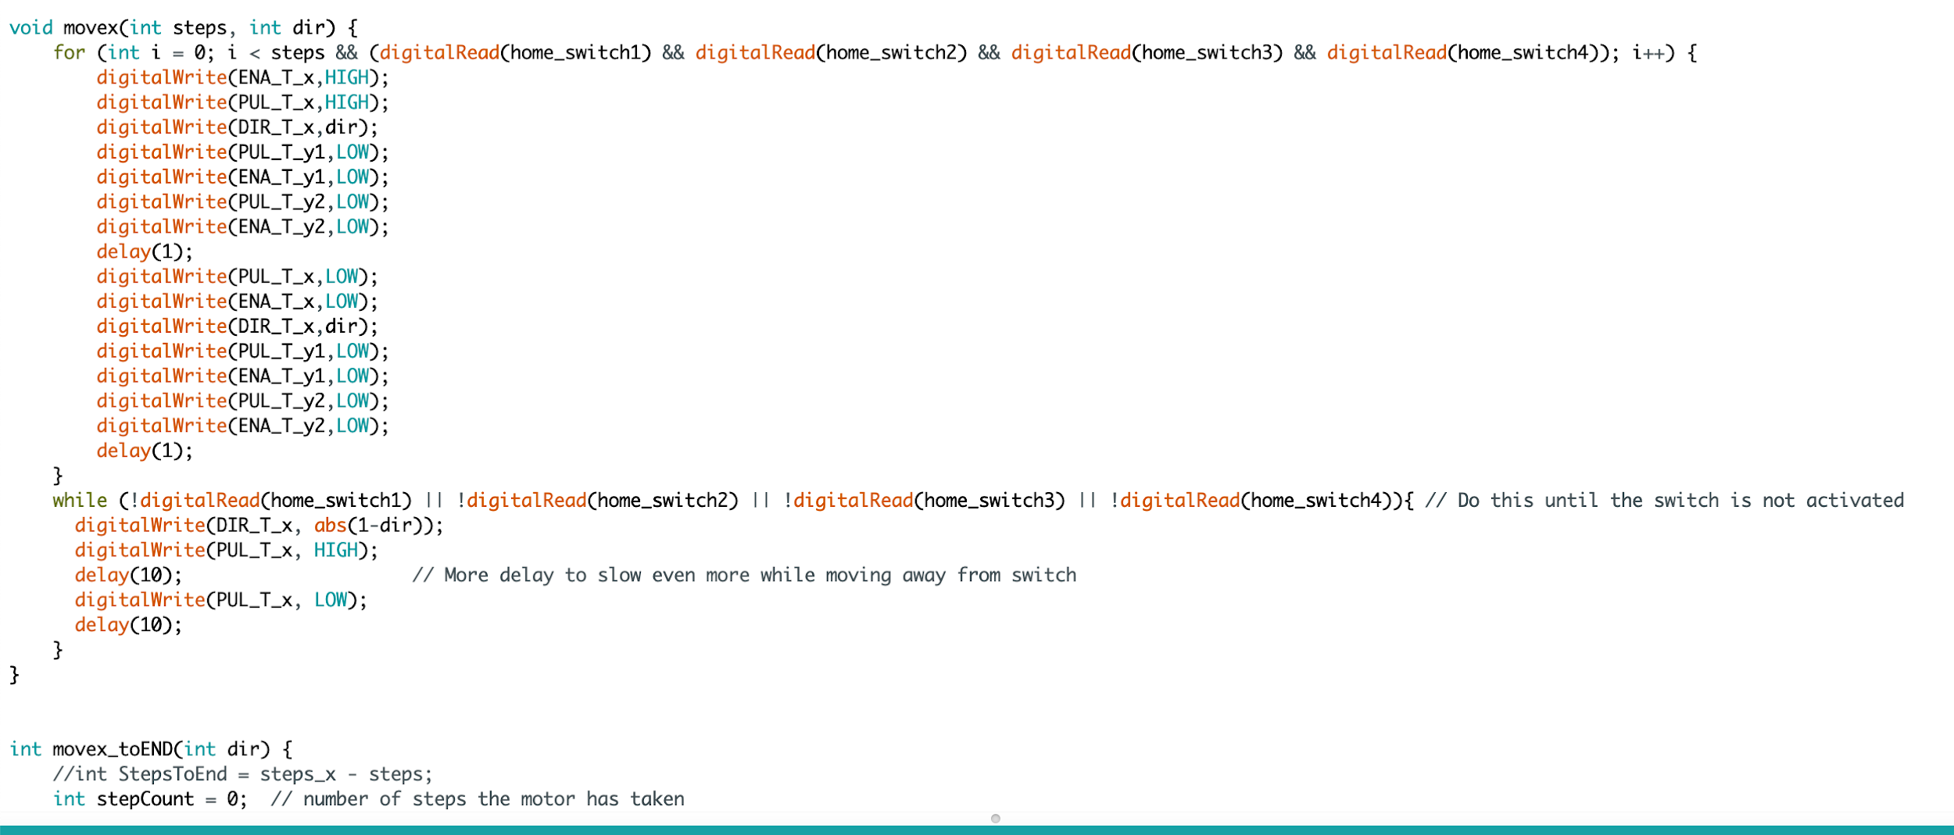
Control Systems
Which motor to move
Which direction (ccw or cw)
Number of steps to take
Arduino
Data Acquisition Computer
Data Acquisition Computer
Python
Implements user inputs to determine scanning parameters
Has a positioning algorithm that follows a unidirectional scanning
Sends a string to Arduino that specifies which motor to move, how many steps to take, and which direction to rotate
Arduino
C/C++
I wrote a calibration program that runs upon turning on
Has functions I wrote that move motors
Uses the string from data acquisition computer as variables in its stepper motor moving functions

Slide 27
Control Systems
Zero point in scanning region
Size of scanning region
Which motor to move
Stepper Motor Driver
Stepper Motor
Scanning resolution
Data Acquisition Computer
Which direction (ccw or cw)
Arduino
Time to spend at each spot over detector
Number of steps to take
Text File
(timestamp, x,y)
Power Supply

Slide 28
Control Systems
Arduino tells stepper motor driver how to move motor
Stepper driver reacts to these command pulses and converts them into the proper on-off pattern required to drive motor
Arduino is connected to the driver with 3 different pins:
Enable - enables coil current in motors
Pulse - sends pulses to the motor
Direction - what direction to turn motor (CW or CCW)
Stepper Motor Driver
Arduino
Notes:
If enable is disabled, there will be no coil current and therefore no holding torque. It is helpful to reduce power consumption.

Slide 29
Control Systems
Zero point in scanning region
Size of scanning region
Which motor to move
Stepper Motor Driver
Stepper Motor
Scanning resolution
Data Acquisition Computer
Which direction (ccw or cw)
Arduino
Time to spend at each spot over detector
Number of steps to take
Text File
(timestamp, x,y)
Power Supply

Slide 30
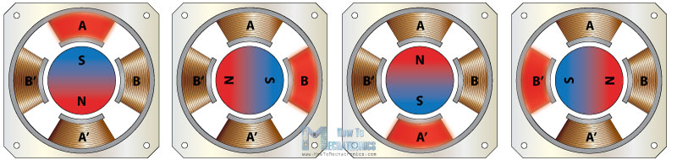
Control Systems
The stepper motor has a rotor that is a permanent magnet and is surrounded by windings of the stator
Driver is connected to the stepper motor with the four windings of the stator: A+, A-, B+, B-
Stepper Motor Driver
Stepper Motor

Slide 31
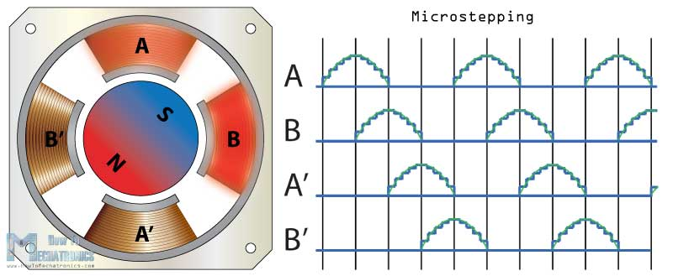
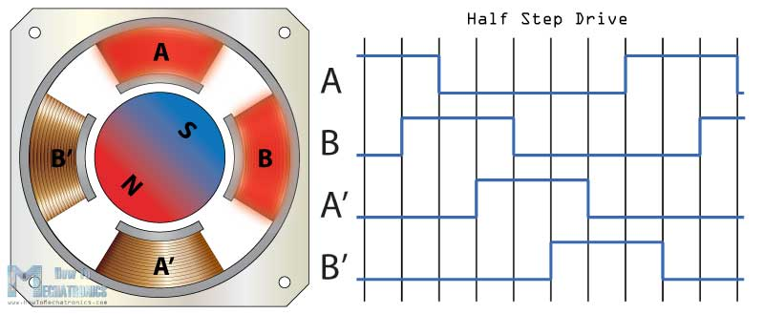
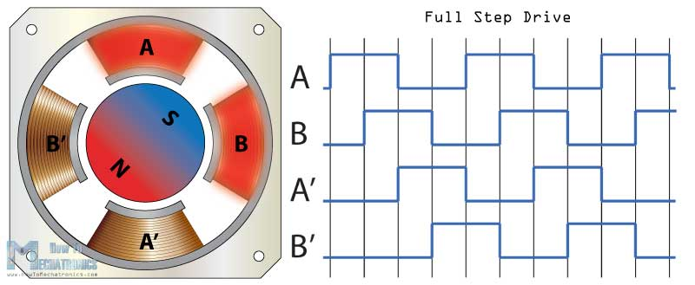
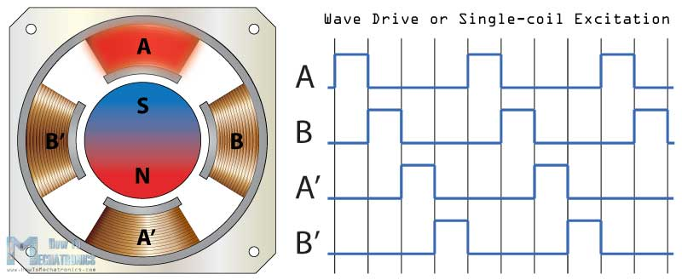
Control Systems
Windings are activated step by step in a particular order, which lets a current flow through them
This magnetizes the stator and makes electromagnetic poles that will cause propulsion to the motor
Driver has 2 main purposes:
Sequencing the phases
Controlling the phase current
Stepper Motor Driver
Stepper Motor

Slide 32
Control Systems
Zero point in scanning region
Size of scanning region
Which motor to move
Stepper Motor Driver
Stepper Motor
Scanning resolution
Data Acquisition Computer
Which direction (ccw or cw)
Arduino
Time to spend at each spot over detector
Number of steps to take
Text File
(timestamp, x,y)
Power Supply

Slide 33
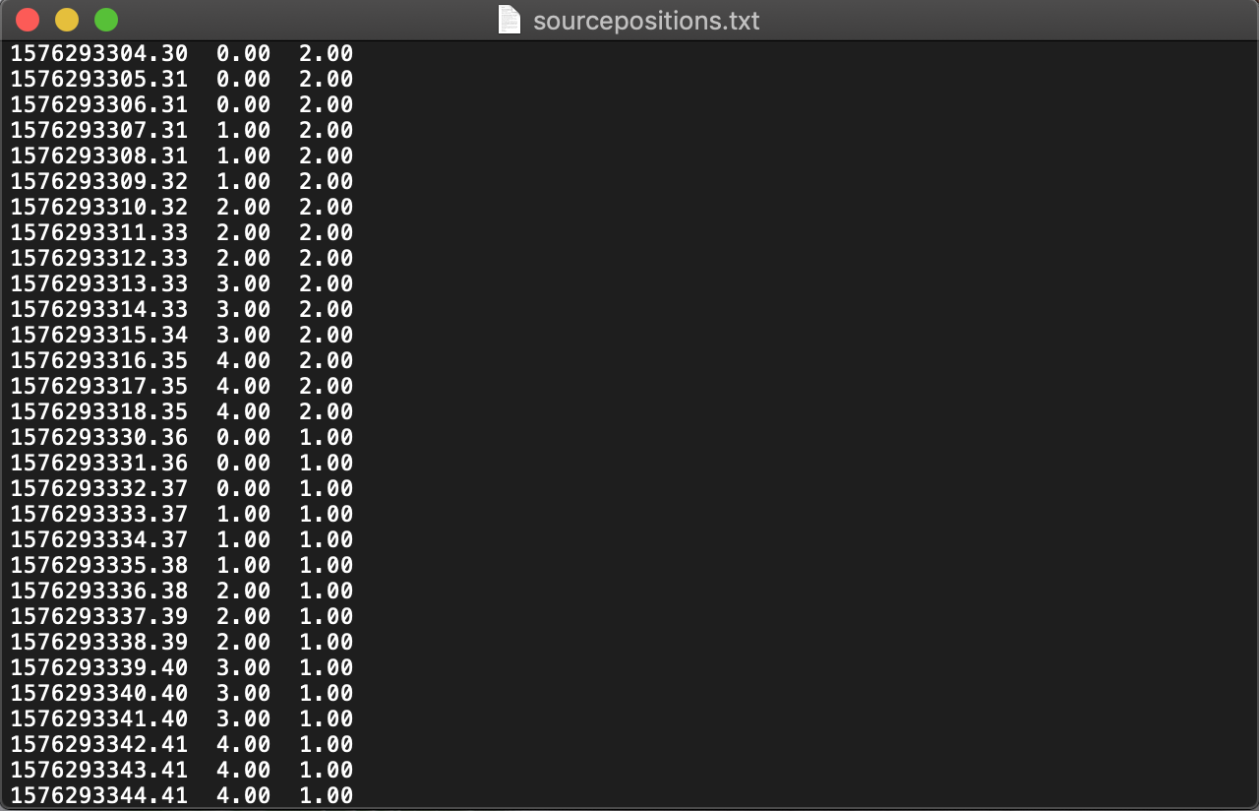
Control Systems
Output during scan
Creates a text file and writes to it every second
File contains timestamps and corresponding x and y positions
Data Acquisition Computer
Text File
(timestamp, x,y)

Slide 34
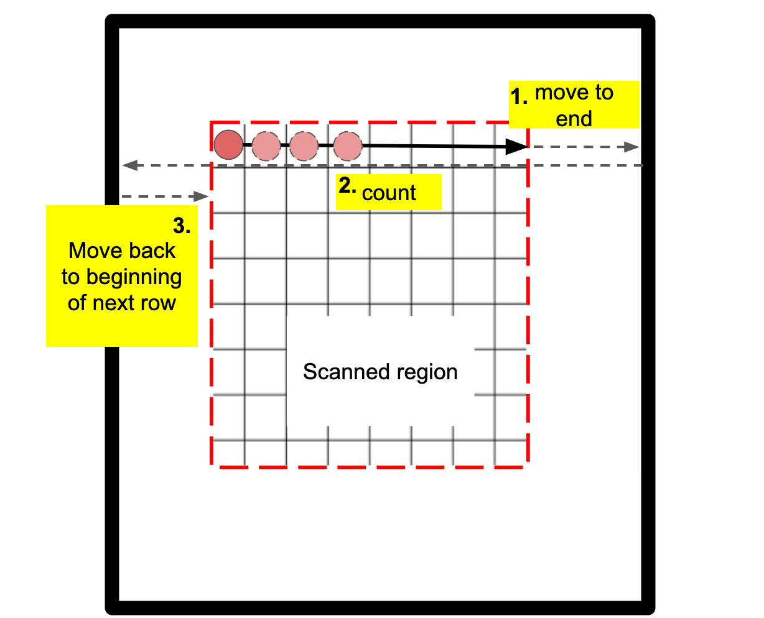
Control Systems
switch
20cm x 40cm region
Top view
Monitoring Error
collimator
At start of scan:
Travels to bottom left corner (home spot) until it reaches the switch
Moves from home spot horizontally and records number of steps to reach switch
Moves vertically and records number of steps to reach switch

Slide 35
Budget
Extruded Aluminum | $65
Linear Guide Rails and Carriages | $79
Lead Screws | $55
Stepper Motors and Stepper Drivers | $78
Arduino and Power Supply | $25
Bearings, Aluminum Pipe, Couplings | $37
Small Electronics (Switches, Wires, Laser) | $31
Assorted Hardware (Nuts, Bolts, Brackets) | $61
 | TOTAL = $431

Slide 36
Another chance
Make it easier to adjust system height (winches or a jack)
Use encoders to track movement → closed loop system rather than an open loop system
Make the device bigger

Slide 37
Acknowledgements
Dr. Clarke, Dr. Fortner, Dr. Riehn - Our mentors
Dr. Green - Our Sponsor
Chris Hewett - Machine shop training and guidance
Ashley Dyer - For helping us order parts
Faculty that attended our meetings and gave valuable feedback:
Zo Webster
Keith Weninger
Richard Longland
Julio Belmonte
Jason Bochinski

Slide 38
Questions

